Slide 1
The Nature of Science and The Scientific Method

Slide 2
Learning Objectives
I can state the 6 steps to the scientific method.
I can explain the 6 steps to the scientific method.

Slide 3
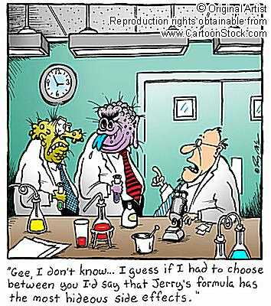
Overview
What is Science?
The Scientific Method
From Hypothesis to Theory

Slide 4
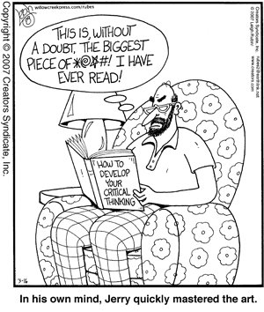
Critical Thinking
Using data and facts to make inferences, draw conclusions, solve problems, etc.
Should be unbiased thought but rarely is

Slide 5
What is Science
SCIENCE IS…..
a way in which answers related to NATURAL events are proposed
a way in which people can learn and UNDERSTAND events in the NATURAL WORLD.
based on OBSERVABLE EVENTS
a study of the NATURAL WORLD
a method of DISCOVERY and UNDERSTANDING by using a PROBLEM SOLVING process called the????

Slide 6
Scientific Method
Scientific Method - A series of steps scientists use to answer questions and solve problems. An organized plan for gathering, organizing, and communicating information.

Slide 7
6 Steps to the Scientific Method
1. Ask a Question
2. Form a hypothesis
3. Test the hypothesis
4. Analyze the Data. Collect, Organize and
5. Draw Conclusions
6. Communicate the results

Slide 8
Step 1: Ask a Question
Ask a question from our observations
Observation – Use of the senses to gather information.
  Sight, Smell, Touch etc.
Observations of natural events usually raise a question
  Why did the water rise when the candle went out?
  Research is usually done to help find out more about the question raised

Slide 9
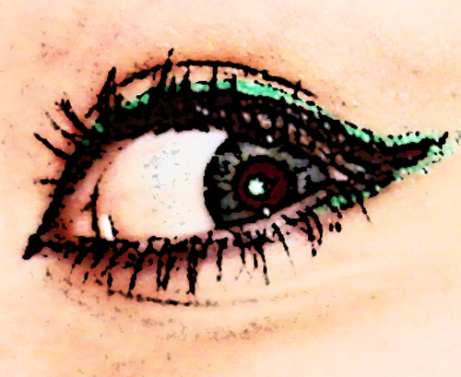

The Observation starts it all…
An observation is a visible or provable fact or occurrence
VS.
An inference is, “the act of reasoning from factual knowledge or evidence.” This is your opinion drawn on the observations you have made.

Slide 10
Step 2: Form A Hypothesis
Based on your observation a Hypothesis is formed that tries to explain your observation or answer your question
  A hypothesis tries to predict or determine the outcome of your experiment even before the experiment is done
    Predictions usually stated in an “if ….. Then” statement. Ex: If I drop a rock then it will fall down toward the ground
HYPOTHESIS MUST BE TESTABLE!

Slide 11
Step 2: Form a Hypothesis Example
Based on an experiment designed to test a hypothesis
If/then statements hypothesis example:
  “If the hypothesis is true, then the results of the experiment will be …”
  e.g. If exposure to fertilizer increases reproduction of bean plants, then the number of pods per plant should increase in plants exposed to fertilizer compared with control plants.

Slide 12
Step 3: Test the Hypothesis
Controlled Experiments are used to test a hypothesis
  A controlled experiment is an experiment that tests only one factor at a time by only I.V. changed.
  a control group is compared with an experimental group. Variables are not changed in the Control Group.
  Control groups allows you to see if a change in a variable creates an observed outcome by comparing the control group with the exp group
  A variable is a factor that changes in a controlled experiment. Variables are changed in the Exp Group AND SERVE AS THE FACTOR TESTED

Slide 13
VARIABLES
Independent Variable (I.V.)
  The variable being changed in the experiment
  Always in the X axis.
Dependent Variable (D.V.)
  The variable that responds to the changed independent variable
  The variable being measured
  Always on the Y axis.
EX: growing plants with different amounts of fertilizer

Slide 14
Variable Examples
The relationship between drug dosage & frequency / intensity of symptoms
Independent: amount of drug administered (dosage)
Dependent: Frequency / intensity of symptoms
The relationship between plant growth rate & duration of light exposure
Independent: Amount of time of exposure to light
Dependent: Plant growth rate

Slide 15
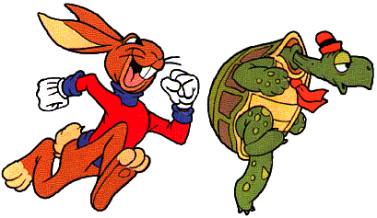

Constants and Controls
A constant is a variable that does not change through the entire experiment…a value that remains the same.
VS.
The CONTROL is the group or condition that is used as the basis for comparison for the results of the changes in the independent variable

Slide 16
Step 3 Continued
Scientists try to design experiments that will clearly show whether a particular VARIABLE caused an observed outcome
IF IT CANNOT BE OBSERVED THEN IT CANNOT BE TESTED!!!
  Can we test if a comet impact killed the dinosaurs? Why or Why Not?
Sometimes models are used to represent a real object
  Used when it is difficult to control all of the variables or not possible to test “the real thing”

Slide 17
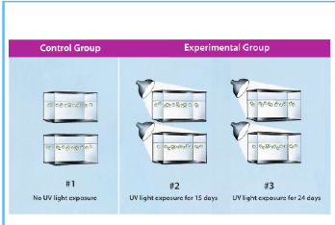
Variables are not
Changed in C.G.
One Variable Changed in
Each Exp. Group

Slide 18
Step 4: Collect, Organize & Analyze Data
Data collected from experiments
  Data is defined as: recorded observations or measurements (qualitative = description, quantitative = number data)
  Based on observations
  Utilize tools or senses: sight, smell, temperature change etc.
Data is organized in tables, charts and graphs so that it can be more easily analyzed

Slide 19
Step 4: 2 Types of data
Quantitative data - are numbers and are obtained by counting or measuring.
Qualitative data - descriptions and involve characteristics that cannot be counted.

Slide 20
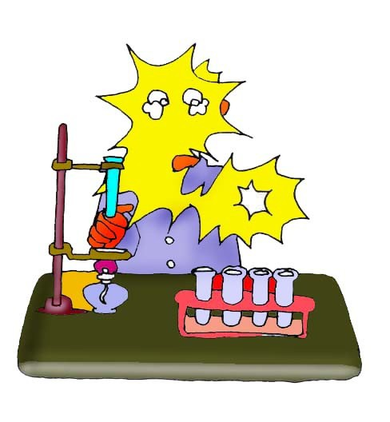
Example: In order to test the effectiveness of a new vaccine, 50 volunteers are selected and divided into two groups. One group will be the control group and the other will be the experimental group. Both groups are given a pill to take that is identical in size, shape, color and texture.
Even though the volunteers are given identical looking pills, the control group will not actually receive the vaccine.
Describe the control group.
Describe the experimental group.
This group will receive the vaccine.
What variables are kept constant?
The size, shape, color, and texture of the pill.
What variable is being changed?
Whether or not the pill contains the vaccine.

Slide 21
Step 5: Draw Conclusions
Scientists decide whether the results of the experiment support a hypothesis.
When the hypothesis is not supported by the tests the scientist must find another explanation for what they have observed
  NO EXPERIMENT IS A FAILURE: All experiments are observations of real events

Slide 22
Step 6: Communicate the Results
Results must be communicated in the form of a written paper or presentation
Communication helps other scientists performing the same experiments to see if the results of your experiment are the same as their results
  Helps people see if results are repeatable!

Slide 23
Theories
Theories are explanations for some phenomena based on observation, experimentation, and reasoning.
  BASED ON MANY EXPERIMENTS
  Experiments that explain a theory MUST be repeatable
  You must be able to predict from a theory

Slide 24
LAWS
Laws are summaries of many experimental results and observations
Laws are not the same as theories because laws tell only what happens, not why it happens.

Slide 25
Technology
    Technology: An application of science to meet the needs of society
    engineers, inventors and creative people apply scientific knowledge to build new “things” or tools
    new technology can lead to new scientific discoveries
      ex: we could not learn about cells before the invention of the microscope
Question: How does science lead to new technology and how does technology add to our scientific understanding of the natural world?

